Slide 2
GETTING STARTED
THIS FILE IS READ ONLY. PLEASE MAKE A COPY:
-- To copy in Google Slides: select File | Make a copy…
-- To download for Powerpoint: select File | Download…
-- If you make a copy: subscribe for new updates here - www.finkube.io
About the FinKube ROI Business Case
The CNCF community provides landscape.cncf.io for project discovery.
FinKube (www.finkube.io) was created as the next step in your Cloud Native journey to create business case and justification
after you have picked relevant CNCF technologies from landscape.cncf.io
How to Use
To use the tool, first download use the FinKube ROI Calculator from www.finkube.io and then
you can take screenshots of the ROI Calculator "Cover sheet" tab for this presentation

Slide 3
<Project Name>
Business Case

Slide 4
Sample Business Case

Slide 5
Business Impact Summary
for <Project Name>
Operational Efficiency
Infrastructure Efficiency via Consolidation
DevOps Productivity
Cloud Migration & arbitrage
Infrastructure Savings: $XXM impact over 5 years
27% Target utilization with Kubernetes
18% Increase over current metrics
Developer Productivity
Developer productivity
Higher release velocity
Lower cost per release
Developer Productivity: $YYM impact over 3 years
194% increase in release velocity
Application
Reliability
Reduce MTTR
Improve uptime
Manage more apps with existing team
Application Reliability: $ZZM impact over 3 years
69% Reduction in unplanned downtime

Slide 6
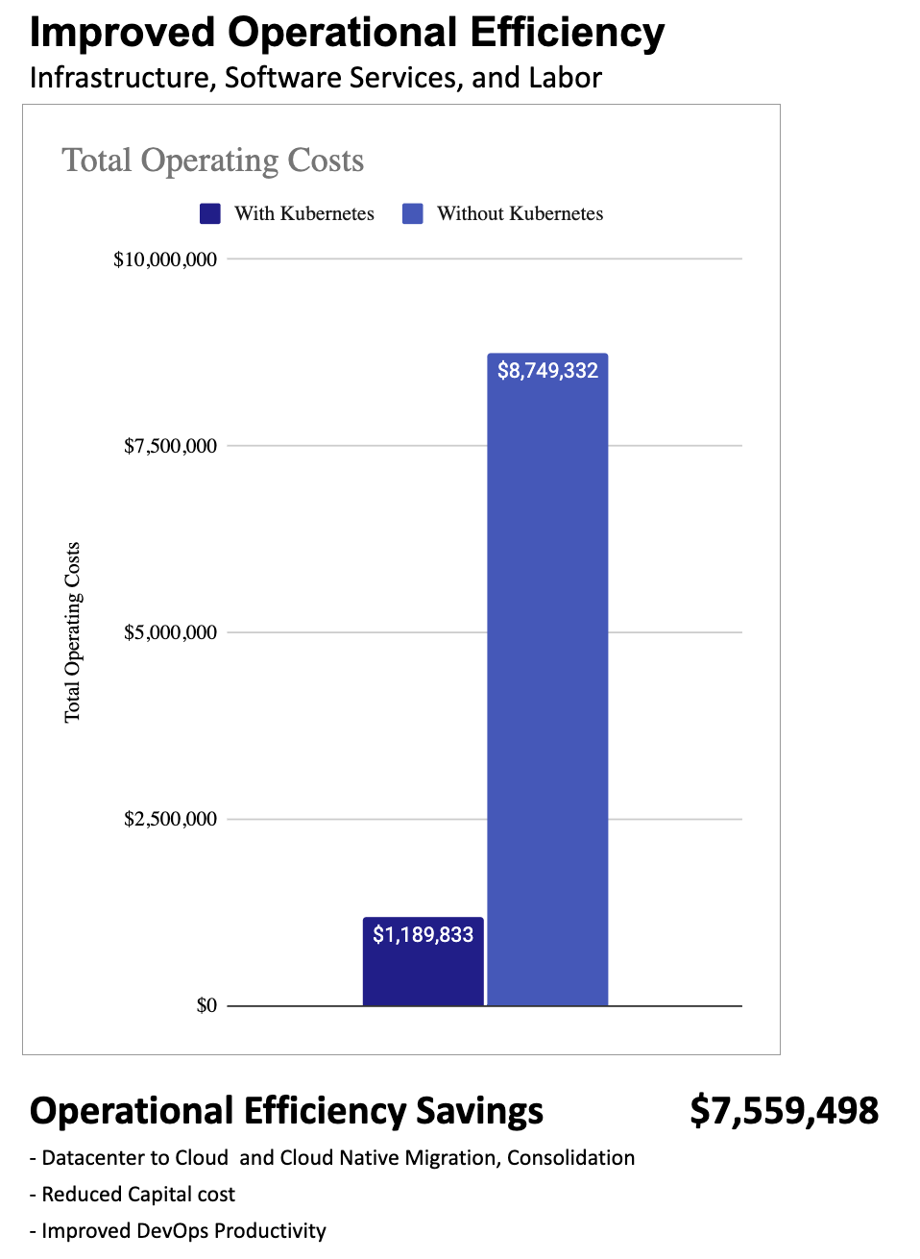
Projected Ops Efficiency Impact
for <Project Name>
Operational Efficiency
Infrastructure Efficiency for Legacy and Cloud Native Apps consolidation on unified infrastructure
Consolidation from Datacenter to Cloud and Cloud Native Migration
Improved DevOps Productivity from Automation
Reduced Capital cost from Consolidation
Cloud Independence, Cloud migration and arbitrage benefits.
USING FINKUBE ROI CALCULATOR

Slide 7
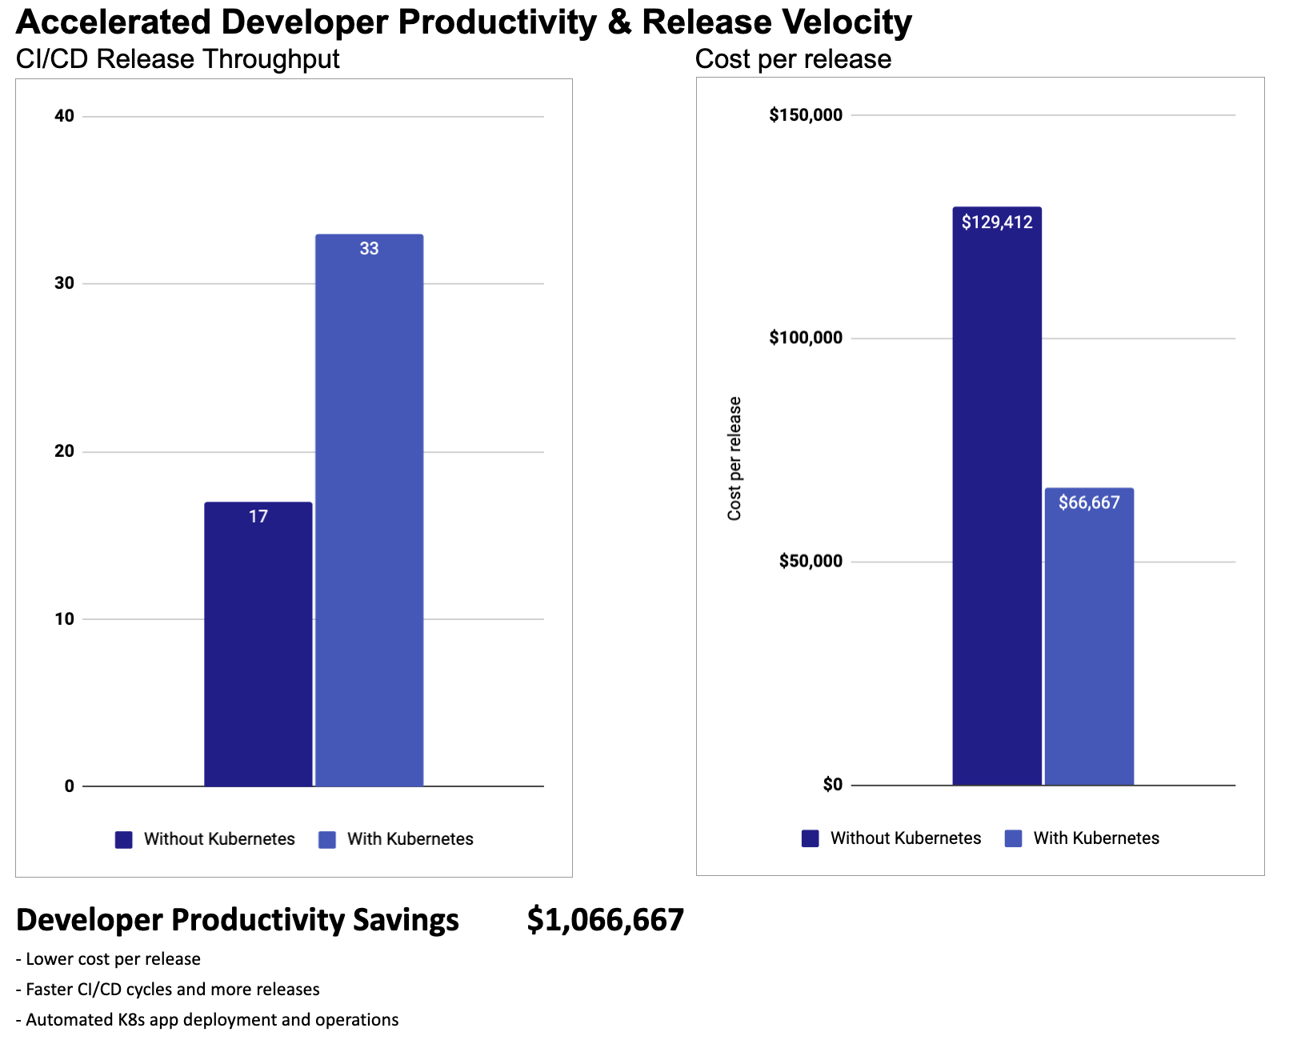
Projected Dev Productivity Impact
for <Project Name>
Development Productivity
Improve Developer productivity
Faster CI/CD cycles and more releases
Lower cost per release
Automated K8s app deployment and operations
USING FINKUBE ROI CALCULATOR

Slide 8
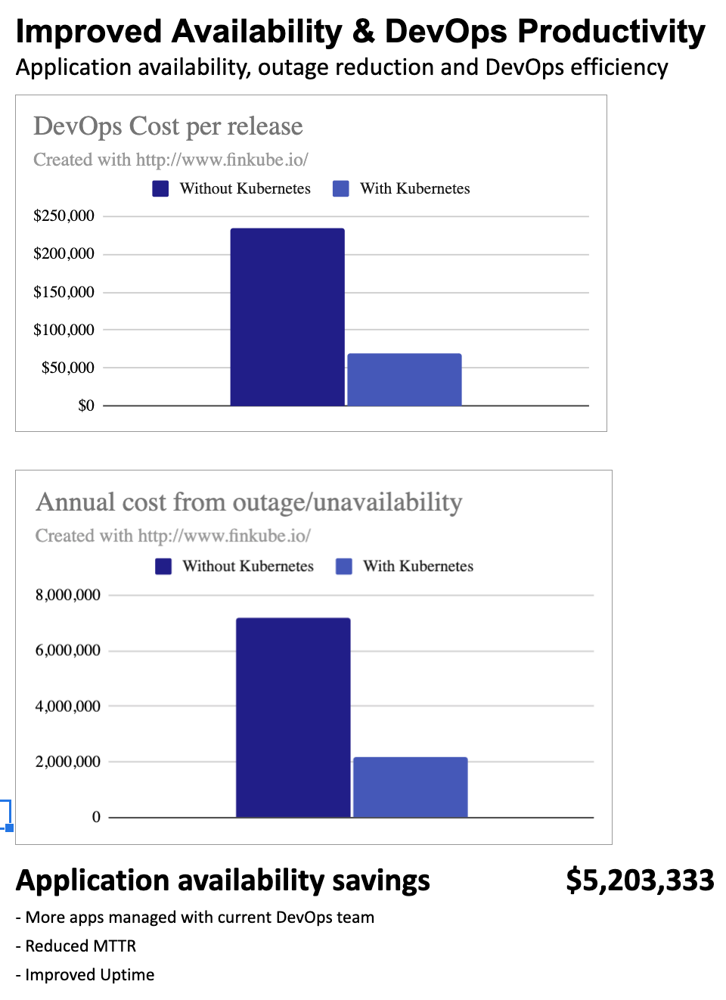
Projected Reliability Impact
for <Project Name>
Application Reliability
Manage more apps managed with current DevOps team
Reduce MTTR
Improve uptime
Reduce unplanned downtime
USING FINKUBE ROI CALCULATOR

Slide 9
Join the FinKube community at www.finkube.io

